Slide 1

DIGITAL DESIGN AND COMPUTER ORGANIZATION
Semiconductor RAM Memories T2 Chapter 5: 5.1 and 5.2
Team DDCO Department of Computer Science and Engineering

Slide 2

Introduction(T2- section 5.1 and 5.2)
Role of Memory
Programs and data are stored in the main memory of the computer.
Execution speed depends on how fast data and instructions are transferred between processor and memory.
Larger memory is needed for executing complex programs that process huge data sets.
The Memory Design Challenge
Ideally, memory should be fast, large, and inexpensive.
However, achieving all three simultaneously is impossible due to cost and technology limitations.
Increasing memory speed or size results in higher cost.
Designers use hierarchical structures to balance speed, capacity, and cost.

Slide 3
Some Basic Concepts (T2- section 5.1 and 5.2)
The maximum size of memory depends on the addressing scheme.
A computer with k-bit addresses can access 2ᵏ memory locations.
Example:
16-bit → 64 K locations
32-bit → 4 G locations
40-bit → 1 T locations
This defines the address space of the computer.
Each address corresponds to one memory location (typically 1 byte).
Most modern systems are byte-addressable — every byte has its own address.
Big-endian: Most significant byte stored at the lowest address (e.g., Motorola 68000).
Little-endian: Least significant byte stored at the lowest address (e.g., Intel x86).
ARM processors can operate in either mode.
Endianness affects data interpretation but not memory capacity.

Slide 4
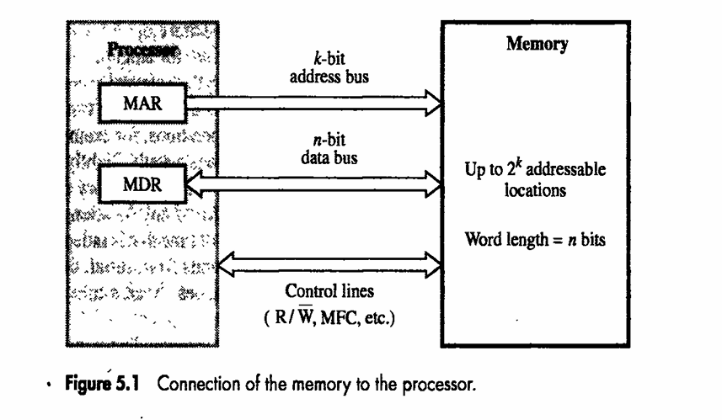
Some Basic Concepts(T2- section 5.1 and 5.2)
Memory stores and retrieves data in word-length units.
A computer’s word length = number of bits transferred in one access.
In a 32-bit system, the address bus (high 30 bits) selects the word; the low 2 bits identify the byte.
Read Operation: Other bytes of the same word may be fetched but ignored by CPU.
Write Operation: Control logic ensures only the targeted bytes are updated.
MAR (Memory Address Register): Holds k-bit address sent to memory.
MDR (Memory Data Register): Holds n-bit data to/from memory.
Address Bus: k bits → selects one of 2ᵏ locations.
Data Bus: n bits → transfers word data.
Control Lines: Read/Write, Memory-Function-Complete (MFC), etc.

Slide 5
Some Basic Concepts(T2- section 5.1 and 5.2)
The memory unit is viewed as a black box that communicates with the processor.
Data transfer between memory and processor is handled through two key registers:
MAR (Memory Address Register) – holds the memory location address.
MDR (Memory Data Register) – holds the data being read or written.
If MAR is k bits long, the memory can have 2ᵏ addressable locations.
If MDR is n bits long, n bits of data are transferred in each memory cycle.
The processor bus has:
k address lines (from MAR)
n data lines (to/from MDR)
Control lines for operations:
R/W → Read (1) or Write (0)
MFC (Memory Function Complete) → indicates operation completion
Other control lines may indicate the number of bytes to transfer.
Communication is synchronized using these control signals.

Slide 6
Some Basic Concepts(T2- section 5.1 and 5.2)
Read Operation:
Processor loads the address into MAR.
Sets R/W = 1 (read).
Memory places data on data lines and asserts MFC.
Processor transfers data into MDR.
Write Operation:
Processor loads address into MAR and data into MDR.
Sets R/W = 0 (write).
Memory stores MDR contents into the addressed location.
Block Transfer:
Used for consecutive memory addresses.
Only the first address is sent; remaining data are transferred sequentially.
Synchronization:
Transfers may be clocked (synchronous) or signal-controlled (asynchronous).
Bus signaling schemes manage timing and coordination.
Read and write transfers correspond to input and output bus operations, respectively.

Slide 7
Some Basic Concepts(T2- section 5.1 and 5.2)
Memory Access Time: Time between the start and completion of a read/write (e.g., Read → MFC).
Memory Cycle Time: Minimum time between two memory operations; slightly longer than access time.
Random-Access Memory (RAM): Any location can be accessed in a fixed time, unlike serial memories (e.g., tapes or disks).
Implemented using semiconductor ICs for fast, reliable access.
The processor executes faster than memory → speed mismatch bottleneck.
Solution → Memory Hierarchy: Use multiple levels (cache + main memory + secondary storage) to balance speed, size, and cost.

Slide 8
Some Basic Concepts(T2- section 5.1 and 5.2)
Cache Memory:
Small, high-speed buffer between CPU and main memory.
Holds frequently used data/instructions.
Reduces average access time; exploits temporal & spatial locality.
Virtual Memory:
Expands apparent size of physical RAM.
Uses logical addresses mapped to physical addresses by the Memory Management Unit (MMU).
Only active portions of a program kept in RAM; inactive pages stored on disk.
Page replacement dynamically loads required pages, maintaining program continuity.
Summary: Cache enhances speed; Virtual Memory expands capacity → together they provide the illusion of large, fast, and cost-efficient memory.

Slide 9
Semiconductor RAM Memories (T2- section 5.2)
Semiconductor memories are available in a wide range of speeds, with cycle times ranging from 100 ns to less than 10 ns.
When first introduced in the late 1960s, they were more expensive than the magnetic-core memories they replaced.
Due to rapid advances in Very Large Scale Integration (VLSI) technology, their cost has dropped dramatically.
As a result, semiconductor memories are now used almost exclusively in implementing main memories.

Slide 10
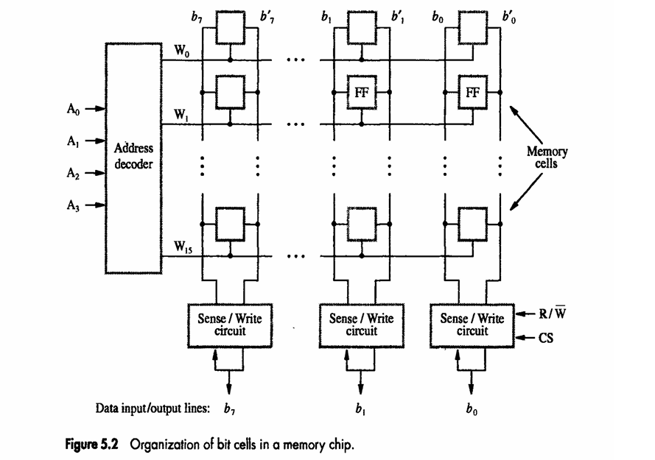
Internal Organization of Memory Chips
Memory cells are usually organized in the form of an array, where each cell stores one bit of information.
Each row of cells constitutes a memory word, and all cells in that row are connected to a common word line driven by the address decoder.
The cells in each column are connected to a Sense/Write circuit by two bit lines.
The Sense/Write circuits are connected to the data input/output lines of the chip.
The address decoder activates one word line (W₀ – W₁₅) based on the input address (A₀–A₃).

Slide 11
Read and Write Operations
During a Read operation, the Sense/Write circuits sense or read the information stored in the selected cells and transmit it to the output data lines.
During a Write operation, the Sense/Write circuits receive input information and store it in the selected cells.
The data input and data output of each Sense/Write circuit are connected to a single bidirectional data line linked to the system data bus.

Slide 12
Example – 16 × 8 Memory Organization
A small memory chip example consists of 16 words of 8 bits each, referred to as a 16 × 8 organization.
Two control lines, R/W (Read/Write) and CS (Chip Select), are provided in addition to address and data lines.
The R/W input specifies the required operation, while the CS input selects a given chip in a multichip memory system.
This memory circuit stores 128 bits and requires external connections for address, data, and control lines.

Slide 13
Larger Memory Org. (1K Memory Ex.)
A larger chip (e.g., 1 K × 1 = 1024 bits) uses a 10-bit address.
The 10-bit address is divided into two 5-bit parts:
Row Address → selects 1 of 32 rows via a decoder.
Column Address → selects 1 bit of the 32 via a multiplexer/demultiplexer.
The 32 × 32 cell array organization provides parallel access within a row.
Uses a Sense/Write circuit, 32-to-1 output multiplexer, and input demultiplexer to manage data flow.

Slide 14
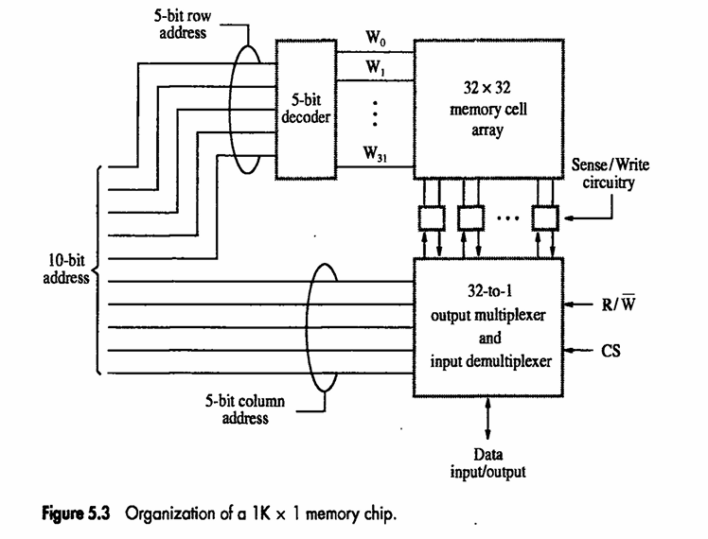
Larger Memory Org. (1K Memory Ex.)

Slide 15
Static Memories
Semiconductor memories are classified into Static RAM (SRAM) and Dynamic RAM (DRAM).
Both store information in binary form but differ in circuit structure, speed, cost, and refresh requirements.
SRAM and DRAM form the primary storage components of computer systems.
SRAM → used for cache memory; DRAM → used for main memory.

Slide 16
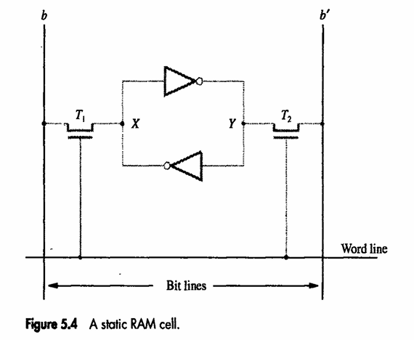
Static Memories
Static RAM (SRAM)
Each cell is made of a bistable latch (flip-flop) that stores one bit.
No refresh is required as data is maintained as long as power is supplied.
Read operation: Word line activates cell, output drives bit lines.
Write operation: Data from bit lines overwrites stored latch value.
Advantages: Very fast access time, stable, simple operation.
Disadvantages: Large cell area, low density, expensive.
Applications: CPU cache, register files, buffering circuits.

Slide 17
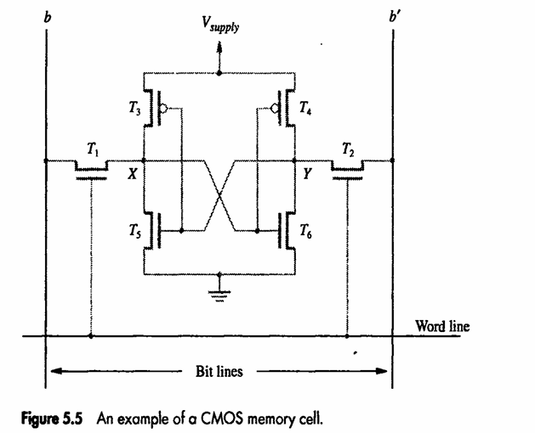
Static Memories
Dynamic RAM (DRAM)
Each memory cell uses a capacitor to store charge (1 bit) and a transistor to control access.
Charge leaks over time → requires periodic refresh cycles.
Read operation: Word line enables transistor; charge on capacitor sensed on bit line, then rewritten.
Write operation: Bit line drives charge into capacitor.
Advantages: High density, low cost per bit.
Disadvantages: Slower access, refresh overhead, destructive read.
Applications: Main memory in PCs, laptops, and servers.

Slide 18
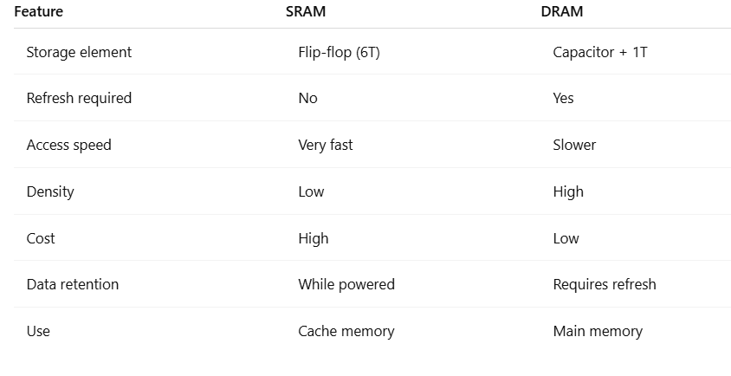
Static Memories

Slide 19
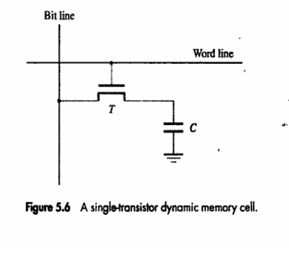
DRAM V/S SRAM
DRAM vs SRAM
SRAM: fast but expensive (6-transistor cell).
DRAM: slower but cheaper (1-transistor + 1-capacitor cell).
Data storage principle
Information stored as charge on a capacitor (C).
Charge leaks in milliseconds → requires periodic refresh.
Cell structure (Fig. 5.6)
1 Transistor (T) + 1 Capacitor (C).
Word line controls transistor gate; bit line connects to I/O.
Read/Write operation
Write: Apply voltage → charge or discharge capacitor.
Read: Sense small voltage on bit line → refresh automatically after read.

Slide 20
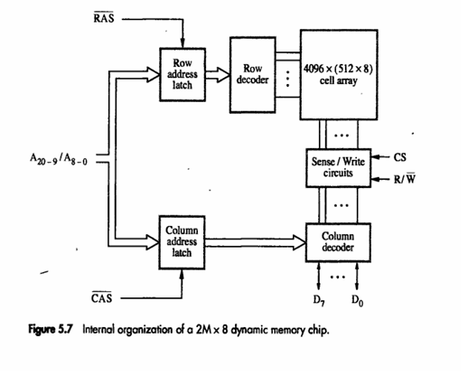
Asynchronous DRAM
Internal Organization of DRAM
Example: 16-Mbit chip.
Array structure
4K × 4K cell array
Control signals
RAS (Row Address Strobe) – latches row address.
CAS (Column Address Strobe) – latches column address.
R/ W line – specifies read or write.
CS (Chip Select) – enables the chip.
Read/Write sequence
Apply row address → RAS asserted.
Apply column address → CAS asserted.
Data transferred to/from bit lines (D₀–D₇).
Automatic refresh
Reading a row refreshes all cells in that row.
Dedicated refresh circuit handles periodic updates.

Slide 21
Synchronous DRAM
SDRAM is a type of DRAM whose operations are synchronized with the system clock. All commands—read, write, refresh—are triggered on the rising edge of the clock.
Structure
Similar cell array as asynchronous DRAM.
Row/column address latch and data registers align transfers with the clock.
Data passes through input/output registers, enabling pipelined operation.
Operation:
Mode register defines timing parameters and burst length.
Clock + control signals (RAS, CAS, CS, R/W) determine data flow.
Burst transfers supported — data placed on output pins each clock cycle.
Read data appears after fixed latency, then continues sequentially (burst mode).
Advantages:
Faster than asynchronous DRAM (no waiting for timing signals).
Supports pipelining and block (burst) transfers.

Slide 22
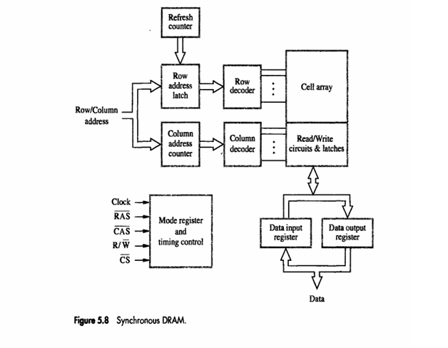
Synchronous DRAM

Slide 23
Rambus Memory (RDRAM)
Purpose & Background
A RAM Bus is a specialized data bus architecture designed by Rambus Inc. to connect the processor (or memory controller) with RDRAM chips. It allows very high data transfer rates through fast signaling on a narrow bus.
Purpose
Traditional SDRAM uses wide buses (64 bits or more) but operates at moderate speeds. Rambus Memory aimed to increase bandwidth without making the bus wider — instead, it made the bus faster.
Rambus Channel Communication Flow
Processor (Master) --> Request Packet --> RAM (Slave)
RAM (Slave) --> Acknowledge Packet --> Processor (Master)
RAM (Slave) --> Data Packet --> Processor (Master)

Slide 24
MCQ
A 1K × 1 memory chip requires how many address lines? a) 8 b) 10 c) 12 d) 16
Answer: (b) Explanation: Number of address lines = log₂(1024) = 10. Each address accesses one bit (1K × 1 = 1024 × 1-bit array)
In SDRAM, the term “burst mode” refers to: a) Writing multiple rows simultaneously. b) Reading or writing a sequence of data words in consecutive clock cycles after a single address. c) Refreshing multiple rows in one clock cycle. d) Transferring data on both clock edges.
Answer: (b) Explanation: SDRAM burst mode allows sequential access to a series of columns within a row in consecutive cycles, improving data throughput

Slide 25
MCQ
Which combination of memory technologies provides the best compromise between speed, cost, and capacity in a typical computer? a) SRAM + DRAM + Magnetic Disk b) SRAM + Flash + Optical Disk c) DRAM + PROM + Cache d) Flash + EEPROM + Tape
Answer: (a) Explanation:
SRAM → Cache (fast)
DRAM → Main memory (moderate speed, cost)
Magnetic Disk → Secondary storage (large capacity, cheap) This combination forms the standard memory hierarchy

Slide 26
THANK YOU
Team DDCO Department of Computer Science and Engineering

